Slide 1


Slide 2
Chapter 2 The OSI Model
Network and Security Fundamentals

Slide 3
Objectives
Describe the Open Systems Interconnection (OSI) model and Transmission Control Protocol/Internet Protocol (TCP/IP) models
Explain the process of encapsulation and decapsulation
Describe Media Access Control (MAC) address tables and virtual local-area network (VLANs)
Compare User Datagram Protocol (UDP), TCP, and common ports

Slide 4
Chapter 2 – The OSI Model
What is the OSI Model ?
The OSI model was developed by the International Organization for Standardization (ISO). It is a layered model that was designed to support different network devices and allow them to communicate dependably with other devices on a network. The OSI model provides a framework for implementing and developing networking devices and standards and explains how network applications on different computers communicate from end to end.

Slide 5
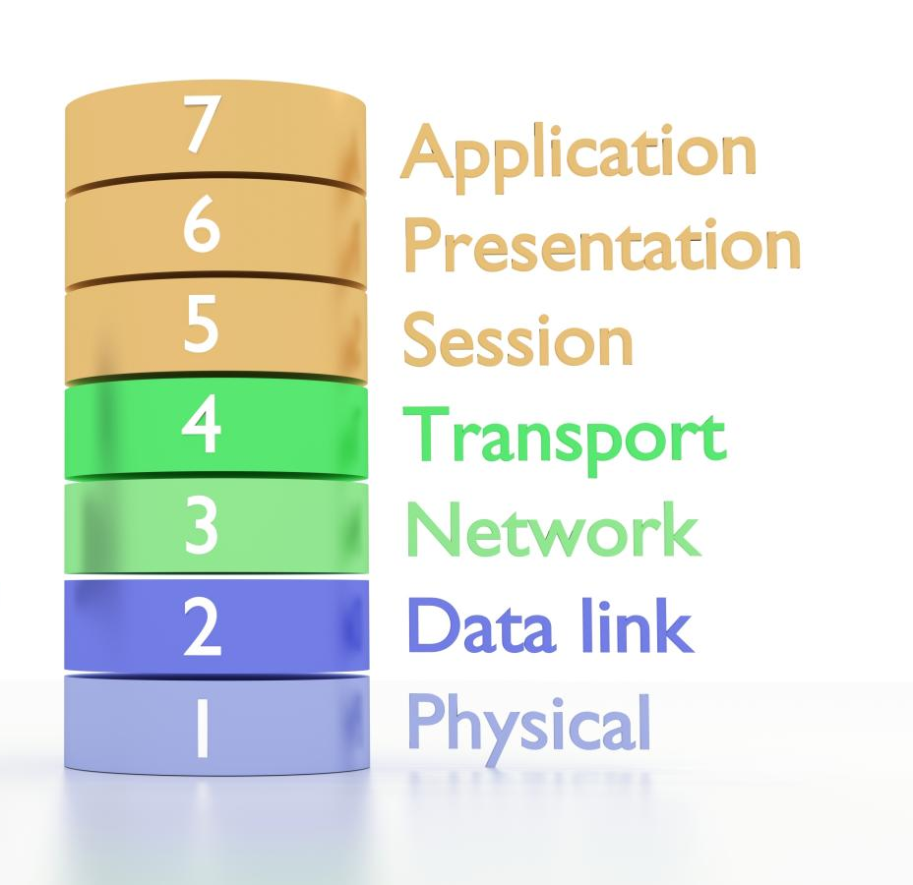
Chapter 2 – The OSI Model
7. Application—provides a user interface
6. Presentation—presents data and syntax processing
5. Session—negotiates and manages communication sessions
4. Transport—provides end-to-end connection, flow control, ensures communications are sent error free
3. Network—provides logical addressing and routing
2. Data Link—provides media access and physical addressing
1. Physical—concerned with transmitting raw binary data across medium

Slide 6
Chapter 2 – The OSI Model
TCP/IP MODEL | PROTOCOLS AND SERVICES | OSI MODEL
Application | HTTP, FTTP, Telnet, NTP, DHCP, PING | Application
 |  | Presentation
 |  | Session
Transport | TCP, UDP | Transport
*Network/Internet | IP, ARP, ICMP, IGMP | Network
*Network Interface/Link | Ethernet | Data Link
 |  | Physical
*Note: The original TCP/IP model used Internet and Link for that last two layers.

Slide 7
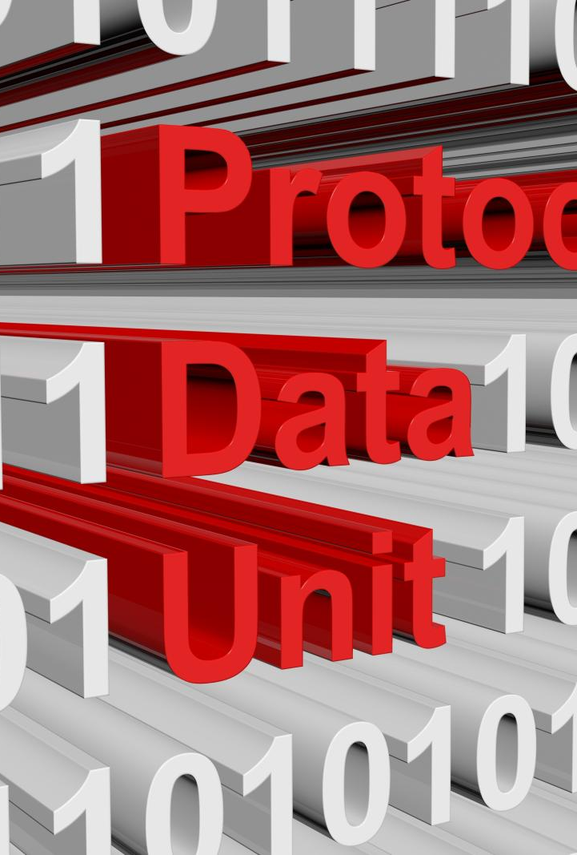
Chapter 2 – The OSI Model
A protocol data unit (PDU) is a term used to identify data as it moves through the layers of the OSI model. At each layer of the OSI model a PDU is referred to by a different name. The PDU can be used as a common term or help distinguish data within specific layers of the OSI model.
For example, at layer 7-5 a PDU is generally referred to as a protocol data unit, however as it moves through the other layers of the OSI model its meaning and characteristics are more significant.
A PDU at Layer 4 of the OSI Model is called a Segment
A PDU at Layer 3 of the OSI Model is called a Packet
A PDU at Layer 2 of the OSI Model is called a Frame
A PDU at Layer 1 of the OSI Model is called Bits

Slide 8
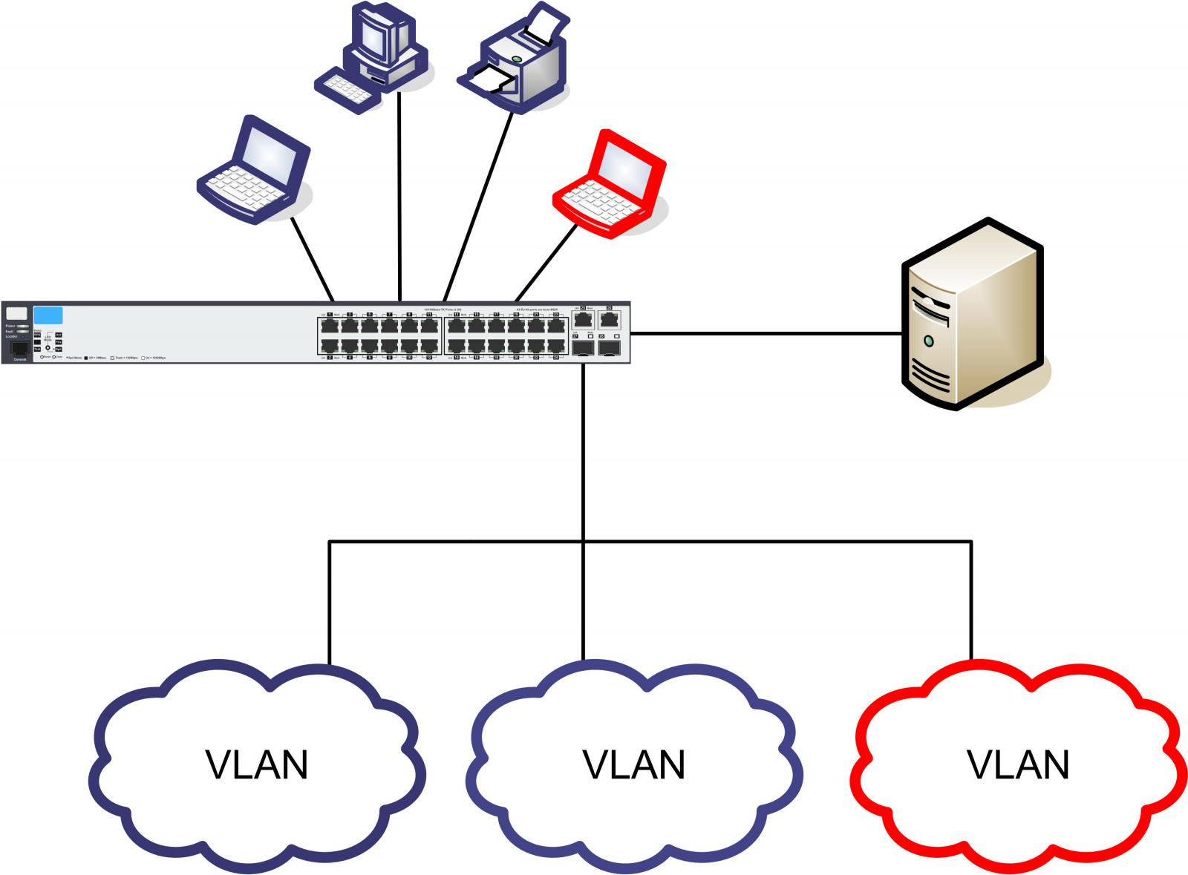
Chapter 2 – The OSI Model
Network switches are hardware based and use the MAC address of different devices on the network to determine where to forward frames. All ports on a switch are mapped to the specific MAC address of the device that physically connects to it. The MAC address and associated port numbers are stored in MAC address tables.
A virtual local-area network (VLAN) is also a concept associated with layer 2 switches. A VLAN is a logical grouping of nodes in the same broadcast domain configured on a switch. This is accomplished by grouping some interfaces/ports into one broadcast domain and grouping some into others.

Slide 9
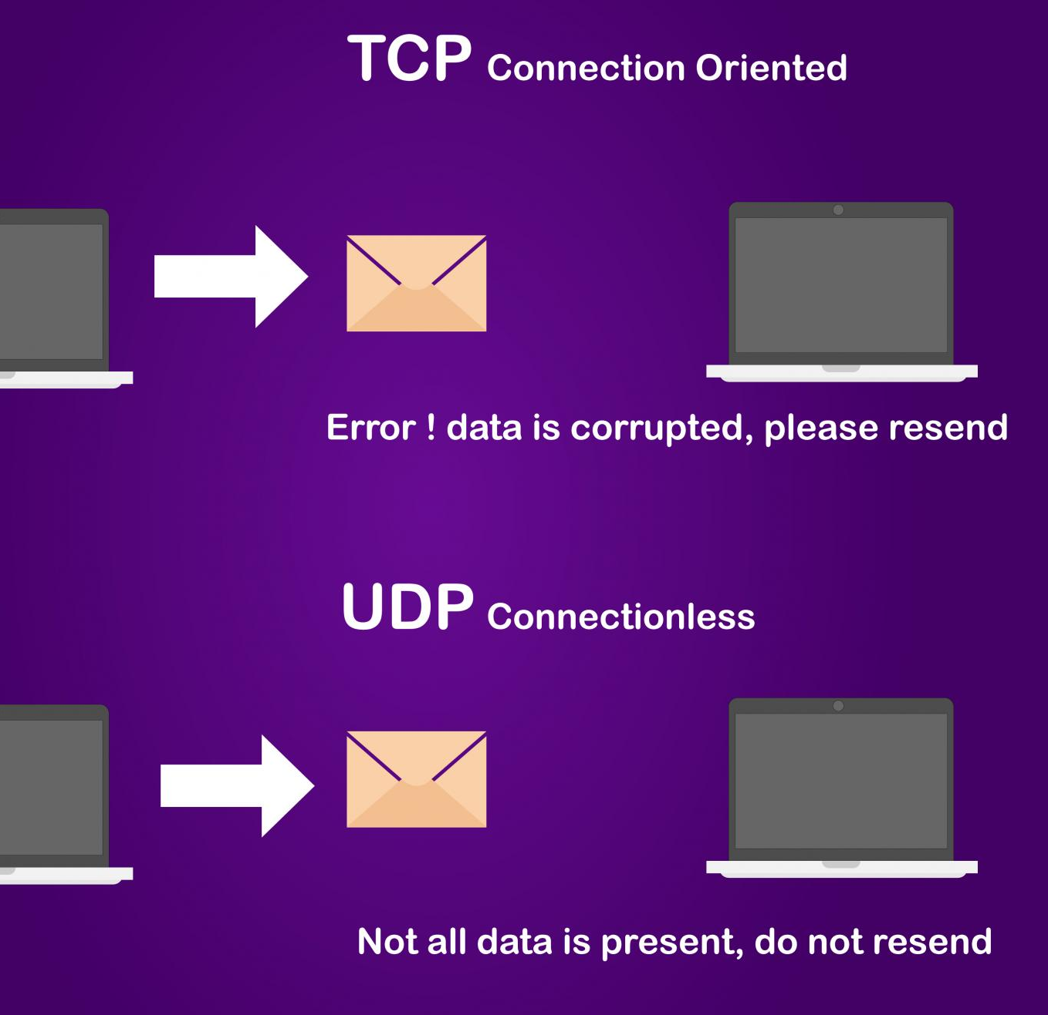
Chapter 2 – The OSI Model
Two commonly used TCP/IP protocols are the Transmission Control Protocol (TCP) and the User Datagram Protocol (UDP). These protocols function at layer 4 of the OSI model and are responsible for end-to-end communication between two devices. TCP is a connection-oriented protocol and UDP is a connectionless protocol.

Slide 10
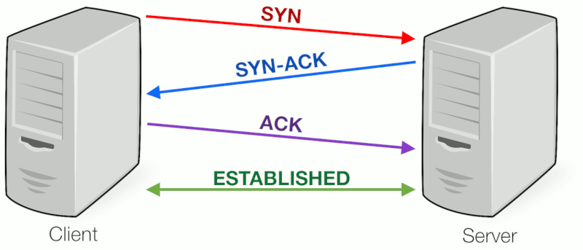
Chapter 2 – The OSI Model
TCP 3 –Way Handshake

Slide 11
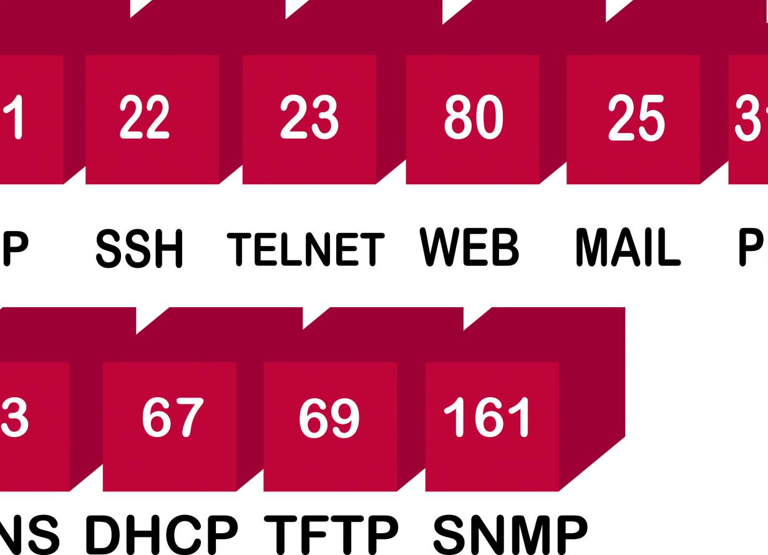
Chapter 2 – The OSI Model
Port numbers range from 0 to 65535. The first 1024 ports are well-known ports and reserved for common protocols and services. It’s important to remember the most common port numbers used on TCP/IP networks in order to regulate network traffic.

Slide 12
Chapter 2 – The OSI Model
Common Port Numbers
TCP | UDP
File Transfer Protocol (FTP)—Port 20, 21 | BootP/DHCP—Port 67
Secure Shell (SSH)—Port 22 | TFTP—Port 69
Telnet Port—Port 23 | SNMP—Port 161
Simple Mail Transfer Protocol—Port 25
Domain Name System (DNS)—Port 53
Hypertext Transfer Protocol (HTTP)—Port 80
POP3—Port 110
Network Time Protocol (NTP) Port 123

